Slide 1
https://tinyurl.com/nc-gis-odm-2017

Slide 2

Stephen Mather, GIS Manager, Cleveland Metroparks
@smathermather

Slide 3
OpenDroneMap is an open source toolkit for aerial drone imagery.
It is modern photogrammetry - fully automated matching, digital surface modeling, and mosaicking

Slide 4
In preparation for the robot takeover.

Slide 5
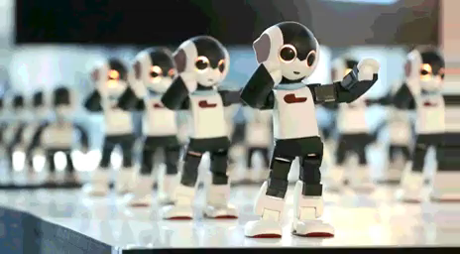
Preparation for the Robot Takeover
Why?
https://imgur.com/gallery/azyruE3

Slide 6
The Future

Slide 7
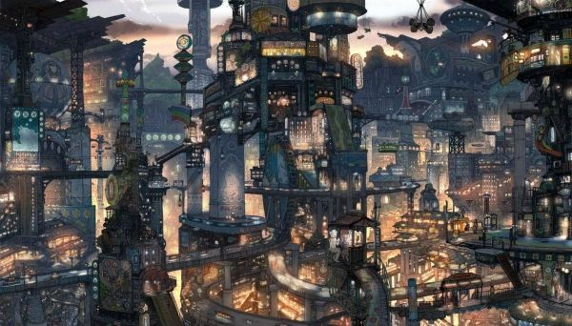
https://s-media-cache-ak0.pinimg.com/736x/61/f0/37/61f037cb982dbd3d9720a107e9373b01.jpg

Slide 8
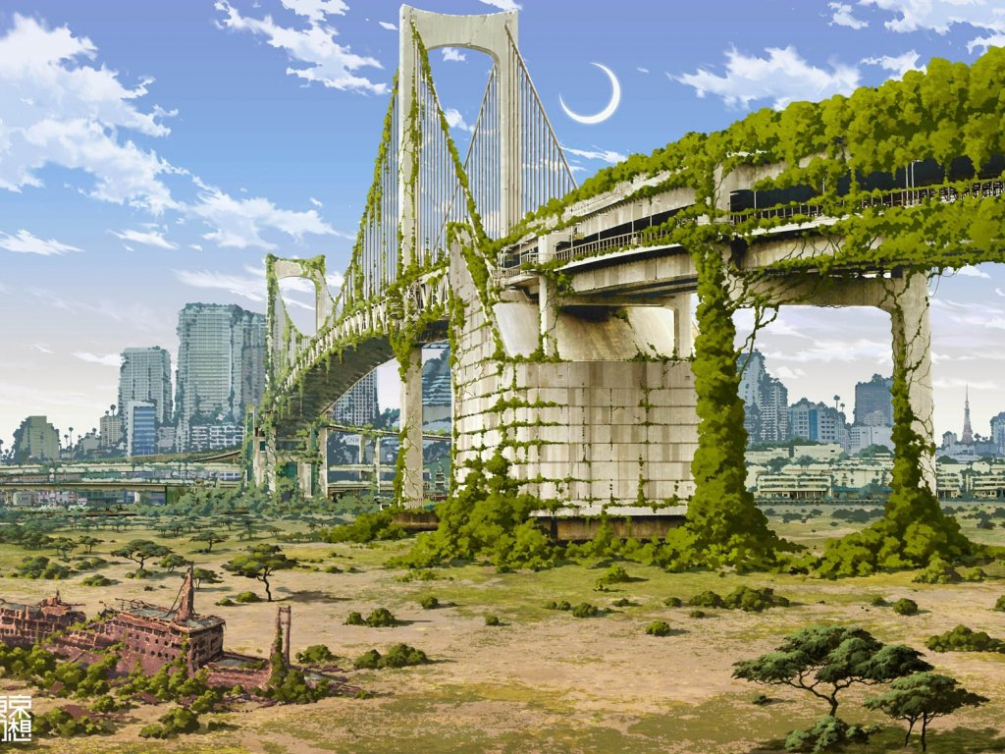
https://www.walldevil.com/6554-bridges-cities-crescent-moon-fantasy-futuristic-japan-landscapes-moss-nature-postapocalyptic-rainbow-bridge-ruins-ships-tokyo-tokyogenso-vehicles.html

Slide 9
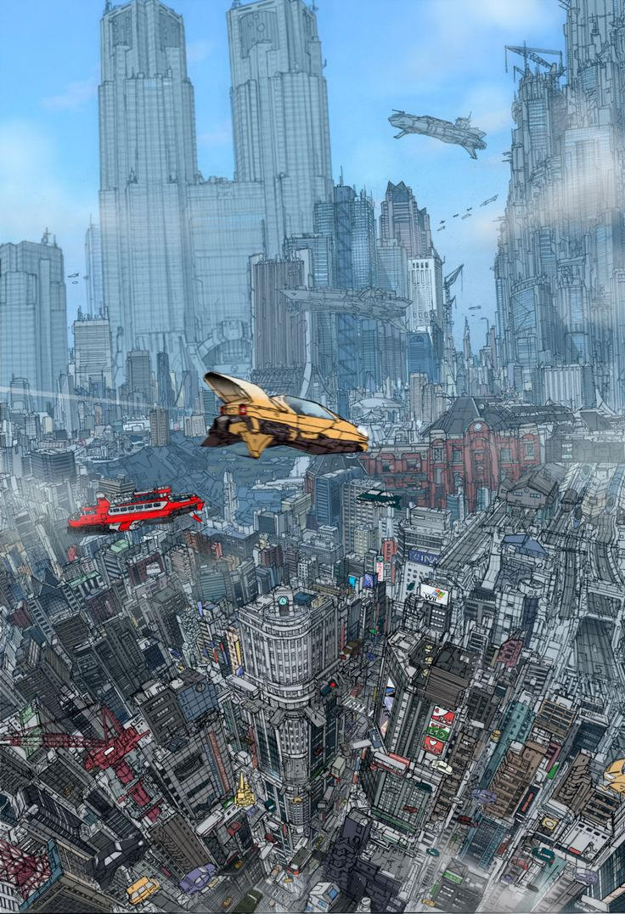
https://s-media-cache-ak0.pinimg.com/736x/36/a5/e7/36a5e797df79b8ed4931d40dc75c0084.jpg

Slide 10
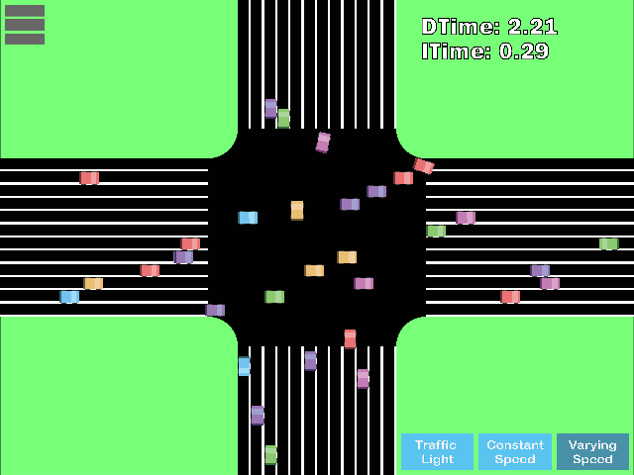

Slide 11
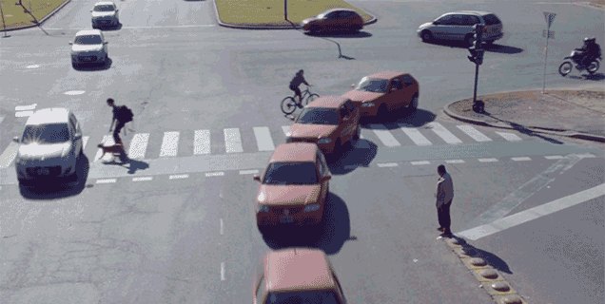

Slide 12
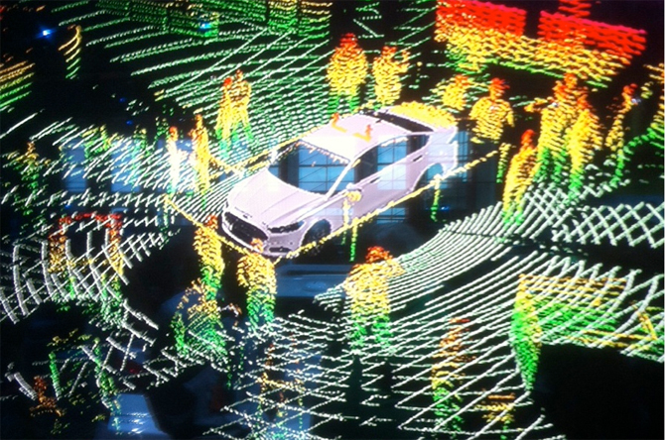

Slide 13
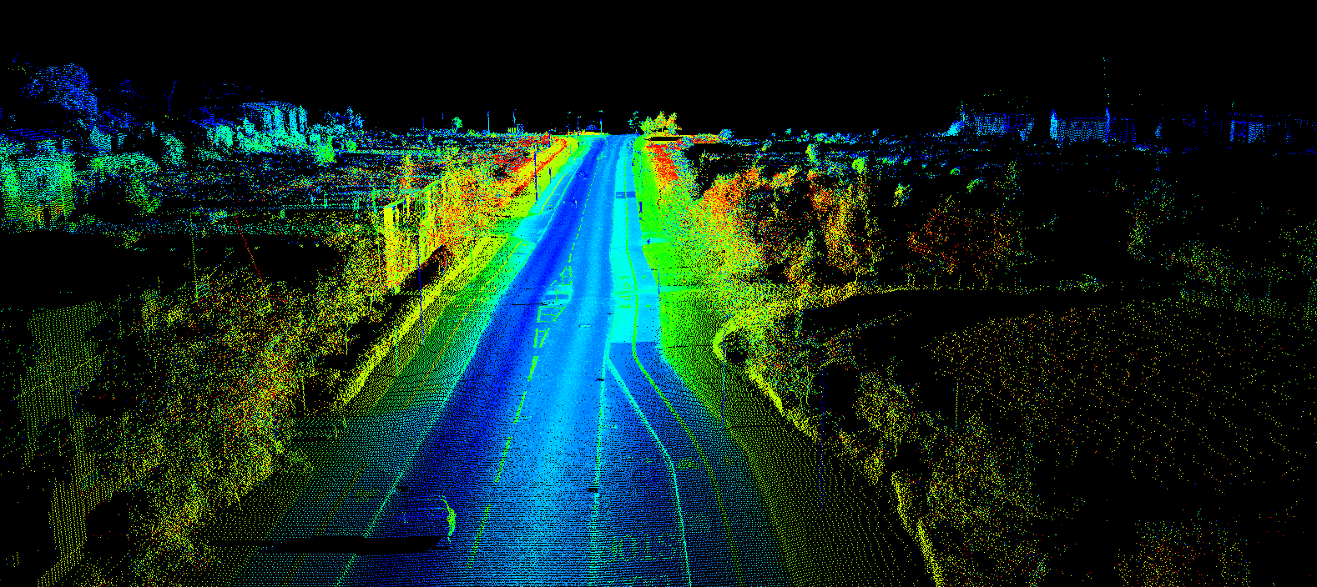
http://www.renishaw.com/media/img/gen/9a5511617ef7479a8d3ddc0917dc5b6d.png

Slide 14
OpenDroneMap is an open source toolkit for aerial drone imagery.
It is modern photogrammetry - fully automated matching, digital surface modelling, and mosaicking

Slide 15
Origins
Computer Vision
Photogrammetry
Notes:
OpenDroneMap originates from Computer Vision, i.e. how do we enable computers to navigate and understand the world.
It depends on stereo vision much like we do to make sense of the world in 3D

Slide 16


Slide 17
Photogrammetry Process
Structure from Motion
Point Cloud Densification
Poisson Surface Reconstruction
Multi-View Stereo Texturing
Orthophoto Generation

Slide 18
Photogrammetry Process
Structure from Motion
Point Cloud Densification
Poisson Surface Reconstruction
Multi-View Stereo Texturing
Orthophoto Generation

Slide 19
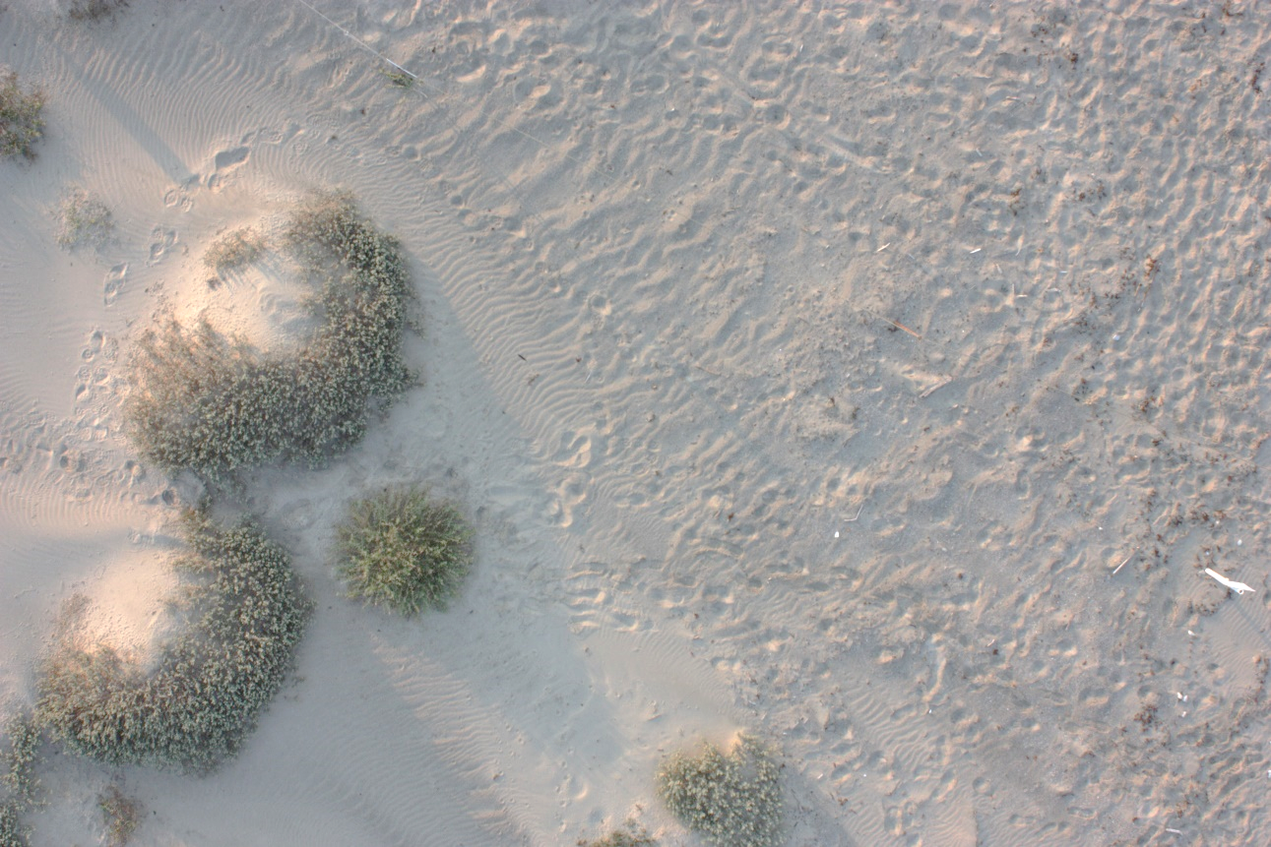
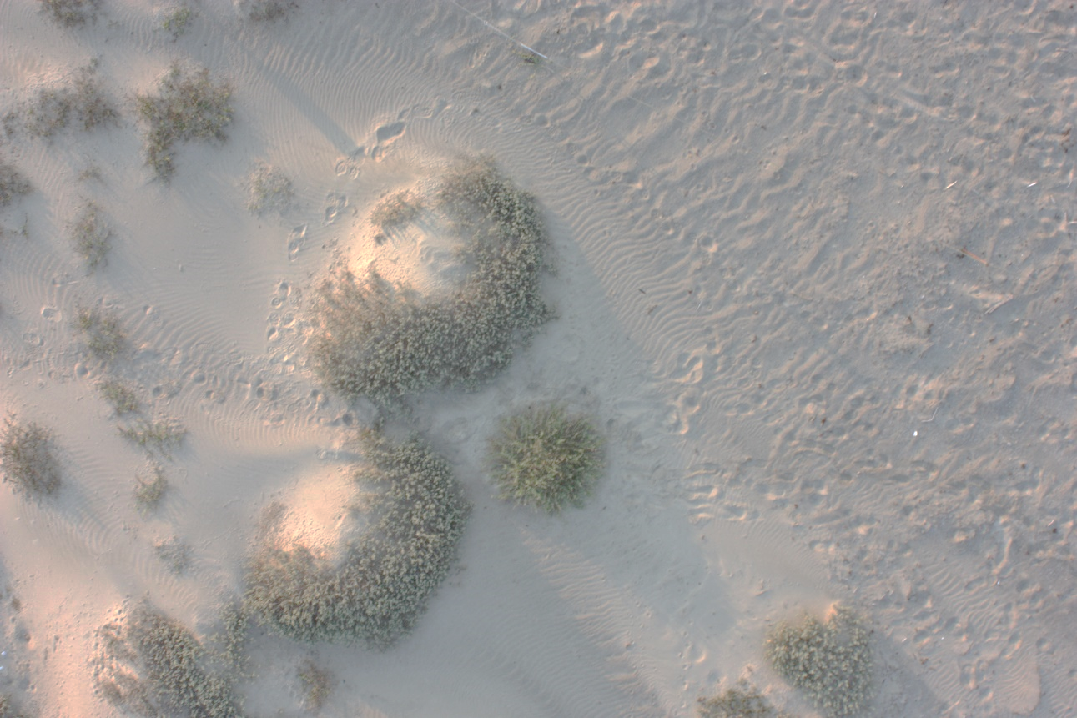
Structure from Motion
Matches features extracted from images with overlap
Credit: Michelle Tobias

Slide 20
Photogrammetry Process
Structure from Motion
Point Cloud Densification
Poisson Surface Reconstruction
Multi-View Stereo Texturing
Orthophoto Generation

Slide 21
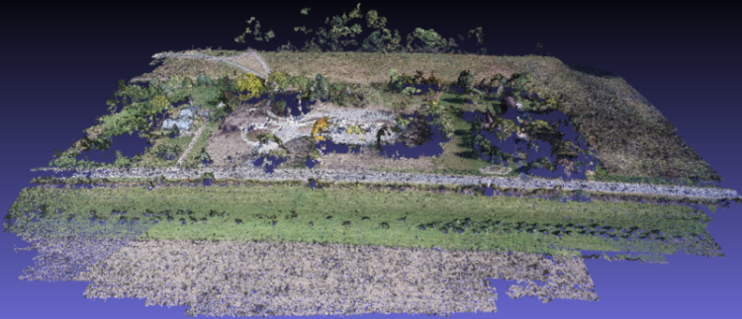
Point Cloud from Matching
Notes:
(Photogrammetrically Derived Point Cloud)

Slide 22
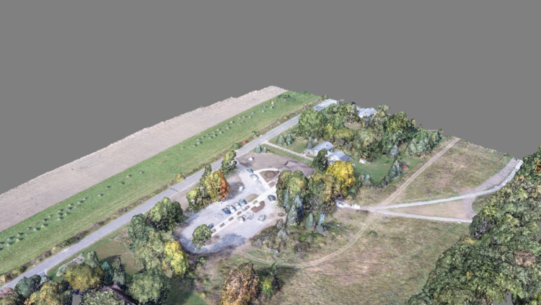
Dense Point Cloud from finding all matches

Slide 23
Photogrammetry Process
Structure from Motion
Point Cloud Densification
Poisson Surface Reconstruction
Multi-View Stereo Texturing
Orthophoto Generation

Slide 24
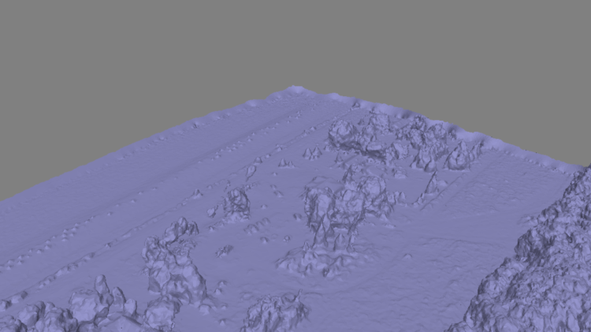
Mesh
Notes:
Uses the Point Cloud Library (PCL), followed by mesh decimation

Slide 25
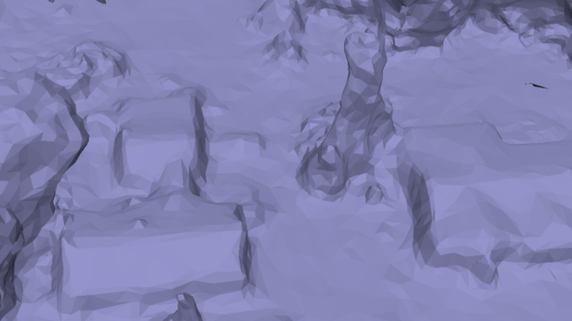
Mesh
Notes:
Uses the Point Cloud Library (PCL), followed by mesh decimation

Slide 26
Photogrammetry Process
Structure from Motion
Point Cloud Densification
Poisson Surface Reconstruction
Multi-View Stereo Texturing
Orthophoto Generation

Slide 27
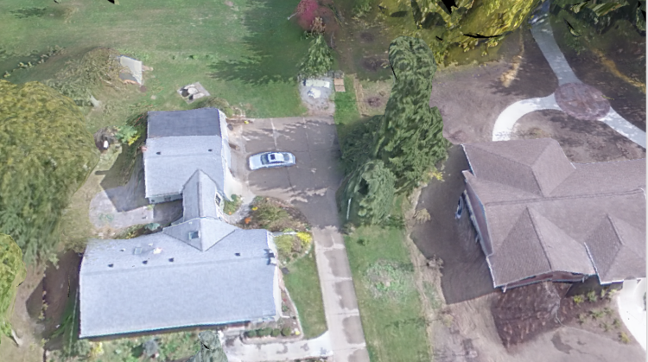
Texturing

Slide 28
Photogrammetry Process
Structure from Motion
Point Cloud Densification
Poisson Surface Reconstruction
Multi-View Stereo Texturing
Orthophoto Generation

Slide 29
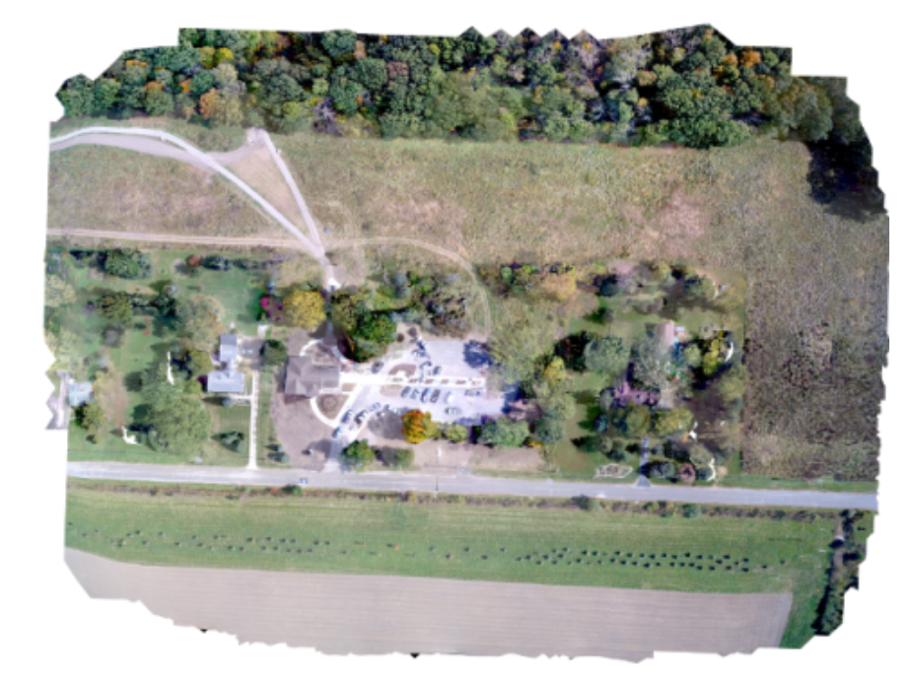
Orthophoto Generation

Slide 30
Questions you may be asking:
This is great, Steve. How do I get started in collecting the necessary datasets for the robot takeover?

Slide 31
How to Use OpenDroneMap

Slide 32
Carefully…

Slide 33
Installation
There are many ways to install ODM:
Natively using Ubuntu 14.04 or later (or with Virtual Machine via vagrant)
MacOS or Windows, by installing Docker (not covered today)
With a Web-based GUI called WebODM

Slide 34
Installation and Usage
Download:
V0.2 Release: https://github.com/OpenDroneMap/OpenDroneMap/releases/download/v0.2/OpenDroneMap-v0_2.zip
Latest Development: (git)
git clone https://github.com/OpenDroneMap/OpenDroneMap.git
Or download link above (sans “.git”)
Install
$ ./configure.sh

Slide 35
Installation (cont.)
3. Set environment variables
Open “~/.bashrc in your favorite editor and append:
export PYTHONPATH=$PYTHONPATH:/your/path/OpenDroneMap/SuperBuild/install/lib/python2.7/dist-packages
export PYTHONPATH=$PYTHONPATH:/your/path/OpenDroneMap/SuperBuild/src/opensfm
export LD_LIBRARY_PATH=$LD_LIBRARY_PATH:/your/path/OpenDroneMap/SuperBuild/install/lib
Replace “/your/path/” appropriately
Log out/in again

Slide 36
Running OpenDroneMap
Project Setup:
Create a project folder and places your images in an "images" directory:
|-- /path/to/project/
|-- images/
|-- img-1234.jpg
|-- ...
Then run:
python run.py -–project-path /path/to/project

Slide 37
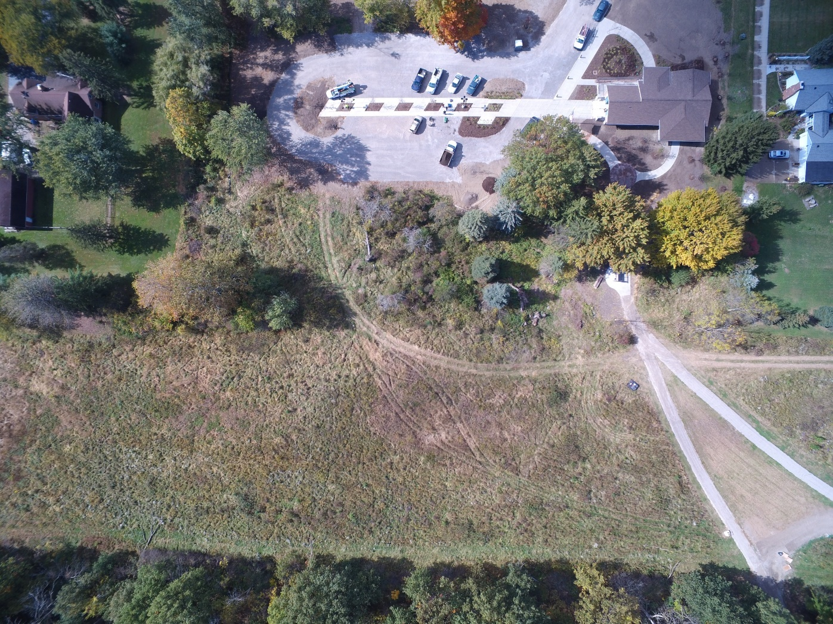
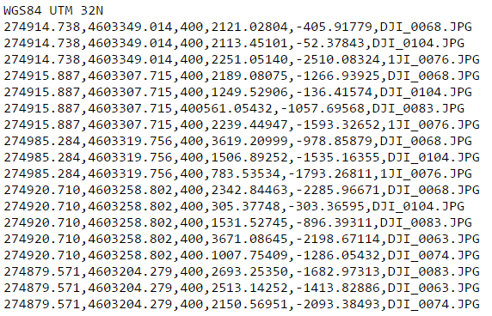
Inputs / Outputs

Slide 38
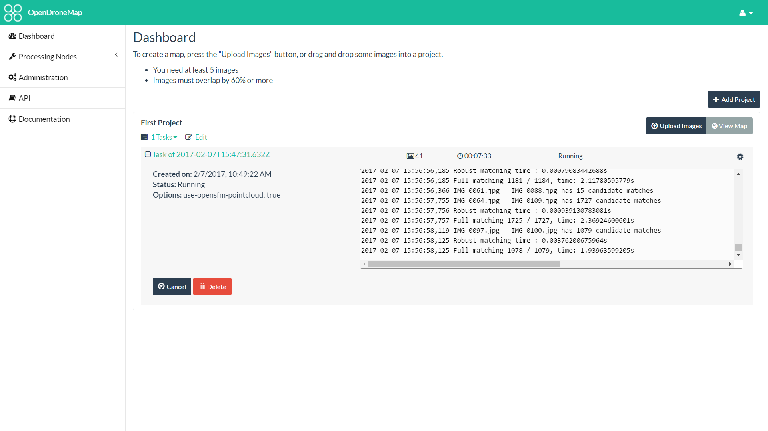

Slide 39
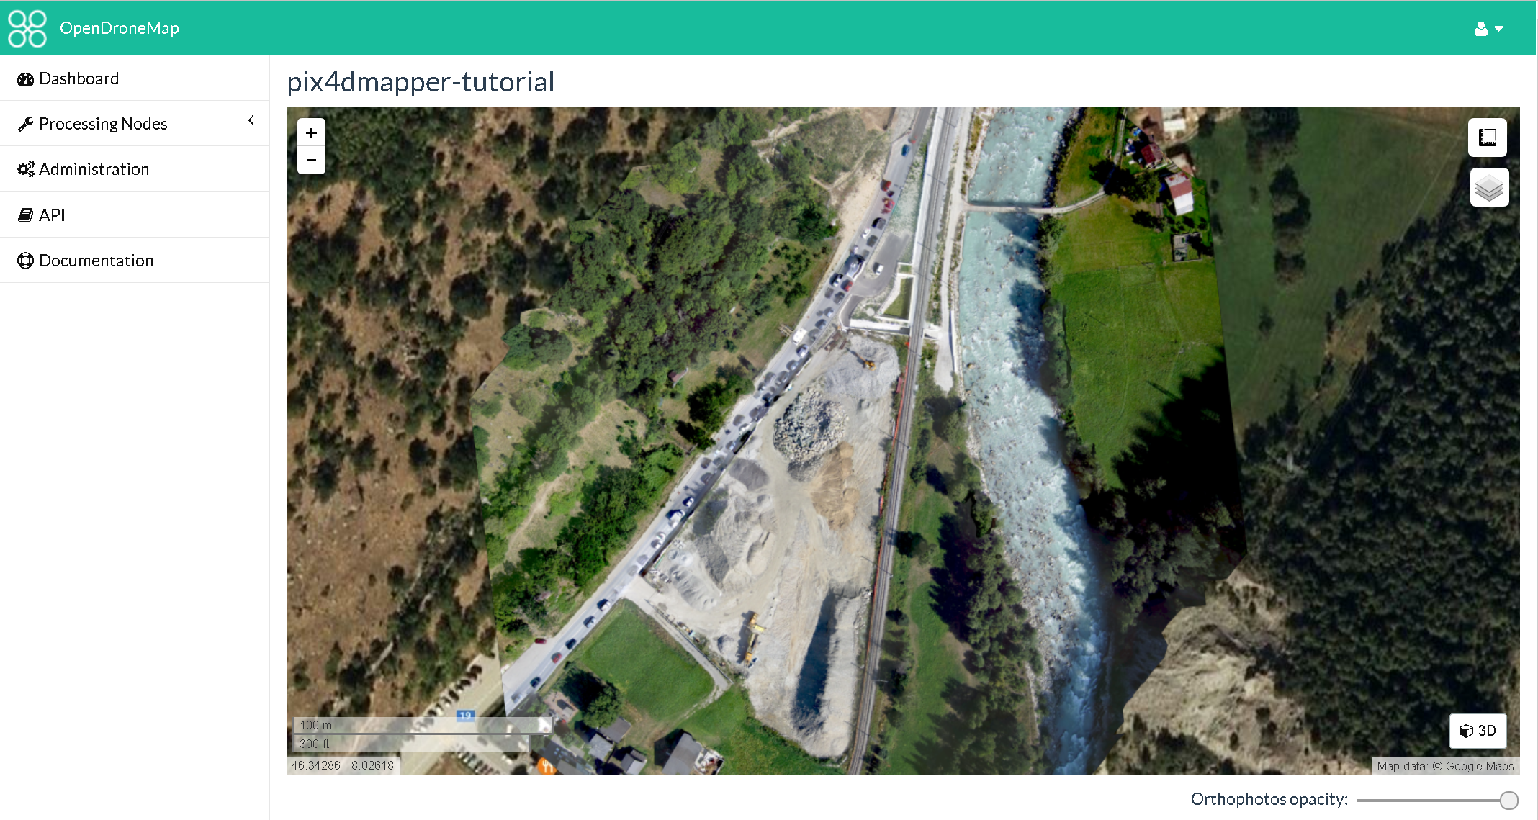

Slide 40
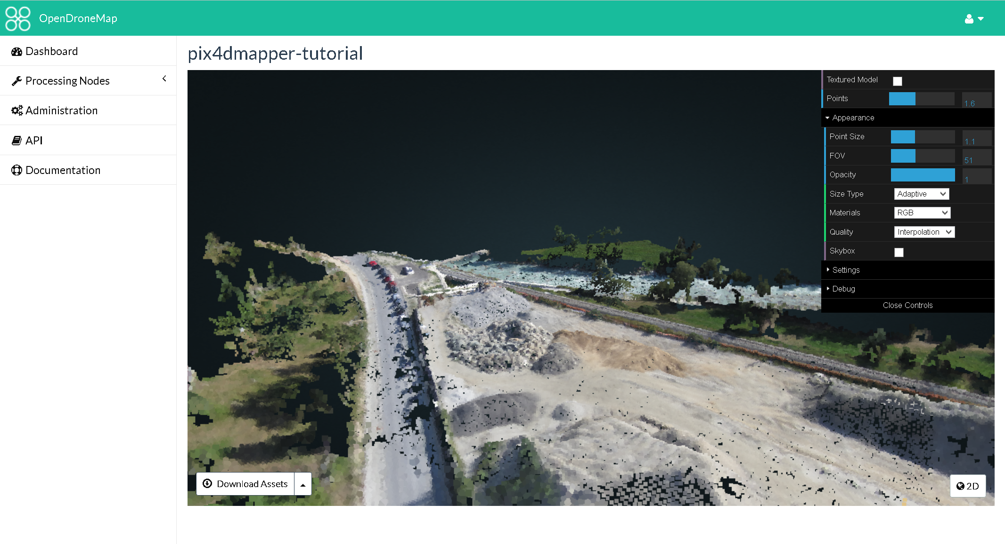

Slide 41
Funding and Future

Slide 42

Funding
Cleveland Metroparks
American Red Cross (FOSS4GNA-2016, Dale Kunce)
Integration with Portable OpenStreetMap (POSM)
Humanitarian Innovation Fund
…

Slide 43
OpenDroneMap: Future
Quality and robustness improvements
Scalability
Reduce memory footprint
Data Partitioning
Analysis
Add automated DTM extraction
Classification
Mesh improvements

Slide 44
DTM Extraction
Near future

Slide 45
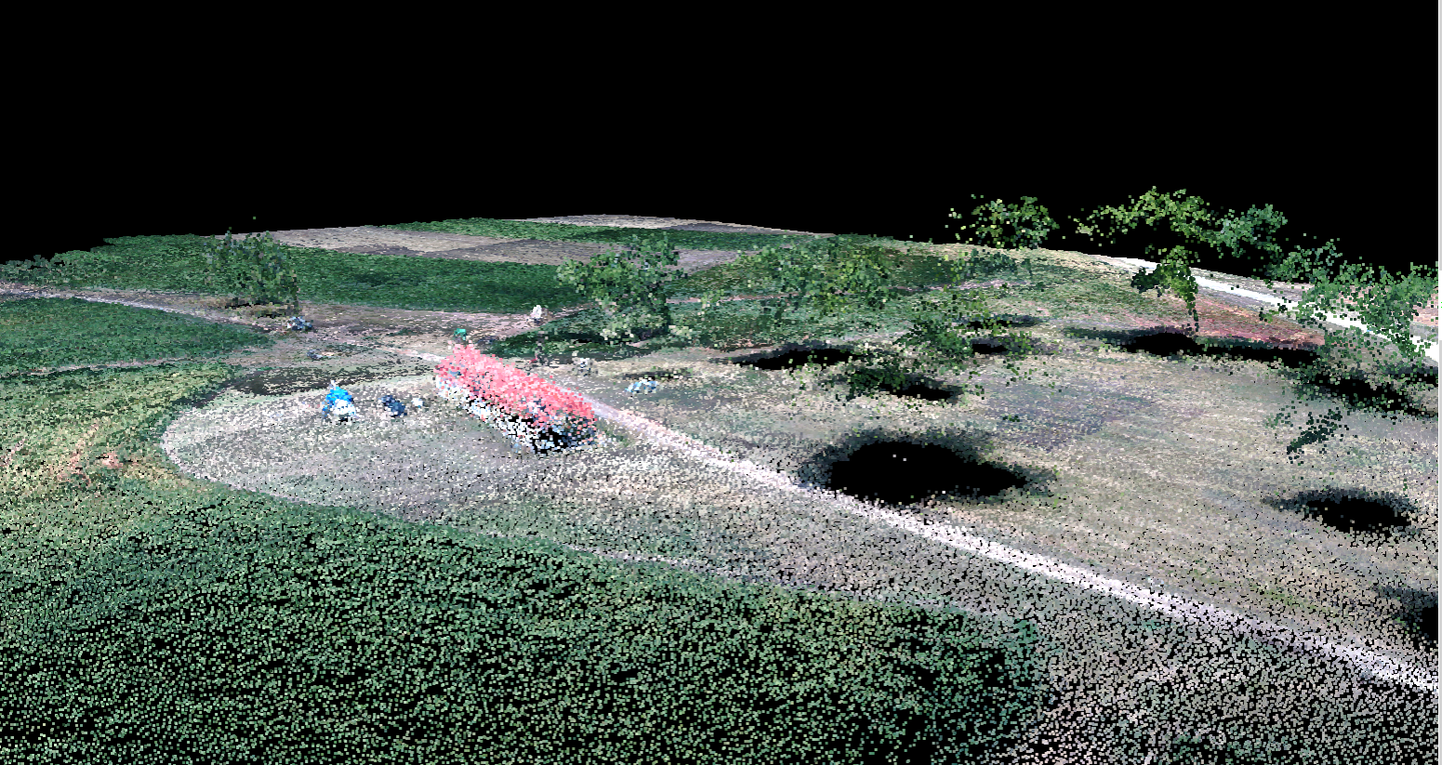
Midpines, flown by NextGen Air Transportation Center (NGAT) access to the data through collaboration with Center for Geospatial Analytics at NCSU

Slide 46
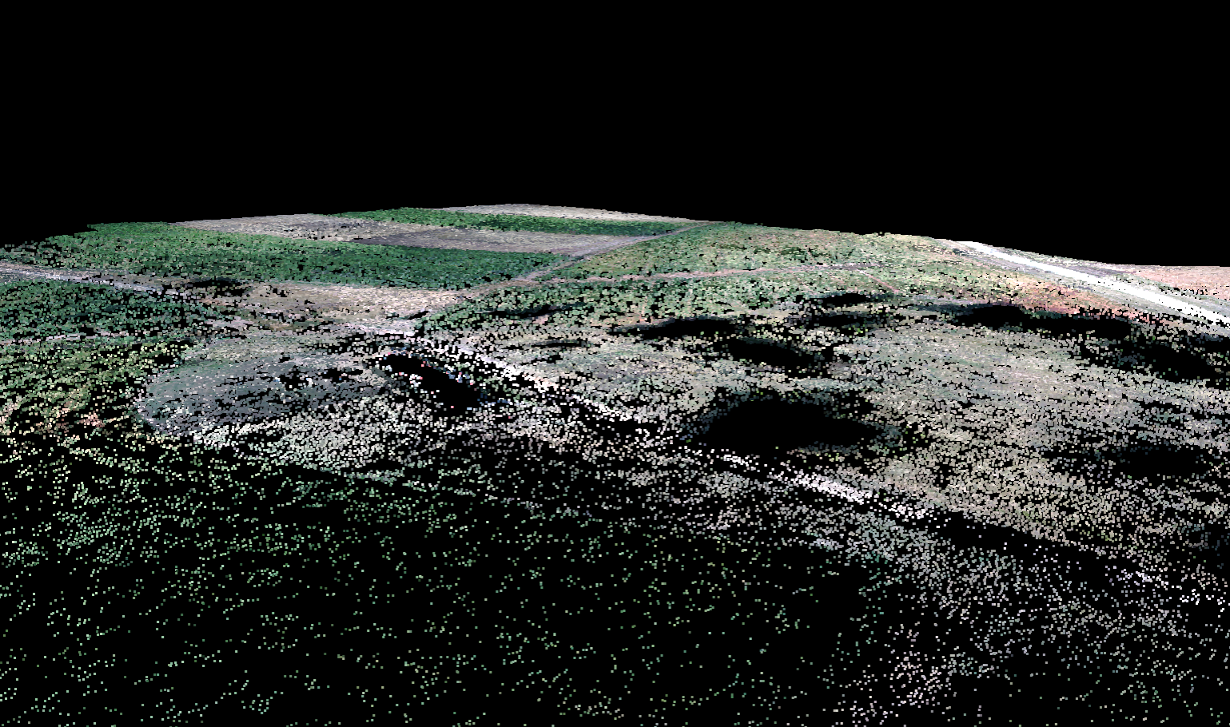
Midpines, flown by NextGen Air Transportation Center (NGAT) access to the data through collaboration with Center for Geospatial Analytics at NCSU

Slide 47
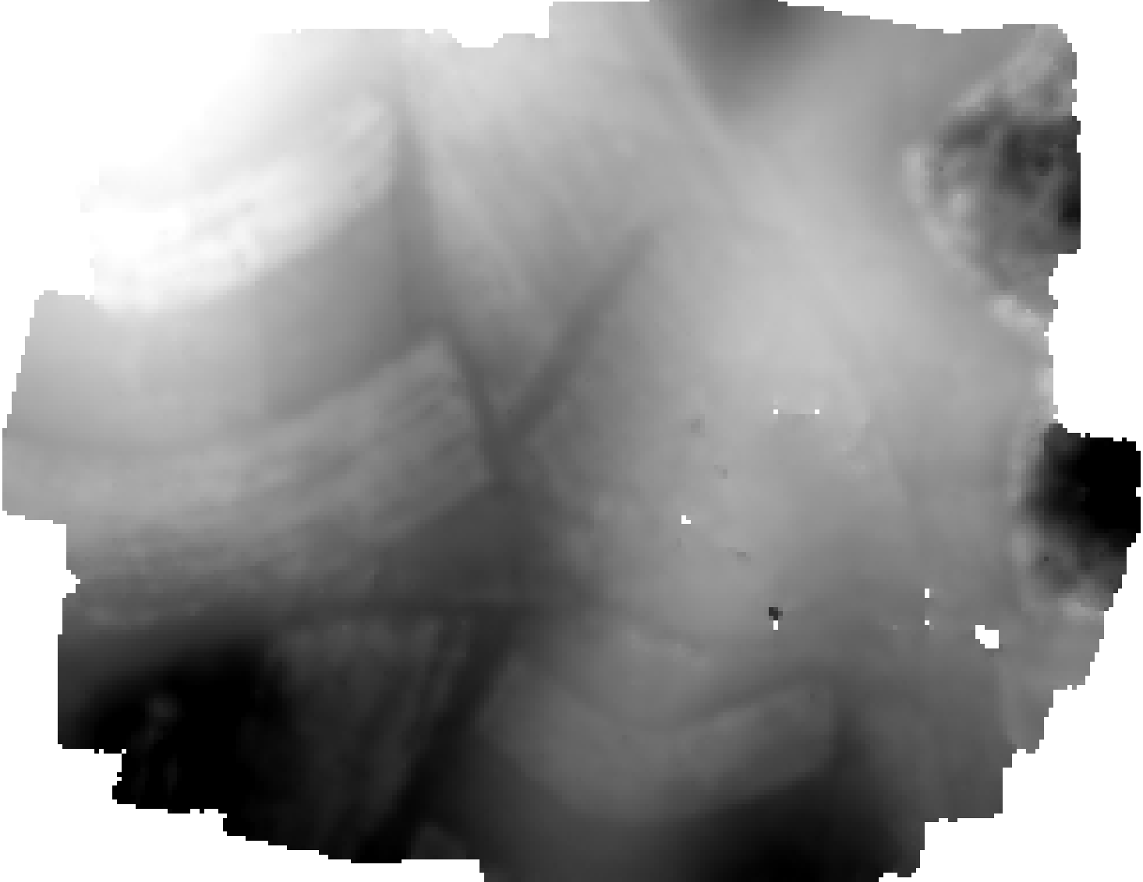
Midpines, flown by NextGen Air Transportation Center (NGAT) access to the data through collaboration with Center for Geospatial Analytics at NCSU

Slide 48
WebODM: Future
DEM display
Volumetric Measurements
Mission Planning
Mobile App for autonomous flight
QGIS integration
Integration with Entwine + Greyhound
Integration with OpenAerialMap

Slide 49
Finish the Live Demo?

Slide 50
https://tinyurl.com/nc-gis-odm-2017

